Slide 1
Statistical Pre-requisites to Machine Learning
Paul, Morgan and Aahana
March 13th , 2020
ML Coffee Hour

Slide 2
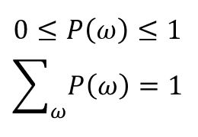
Probability
"Probability deals with predicting the likelihood of future events, while statistics involves the analysis of the frequency of past events."
Probability: likelihood that an event is going to occur
Sample Space (Ω): A set of all possible outcomes
For classification, our possible outcomes could be {-1,1}
For regression, the sample space could be all real numbers
Only one outcome from the sample space is possible at a time
Event: Outcome from an experiment that lies in the sample space
Notes:
In machine learning, our goal is often to predict future events, therefore we need probability to understand the underlying principles in machine learning.

Slide 3

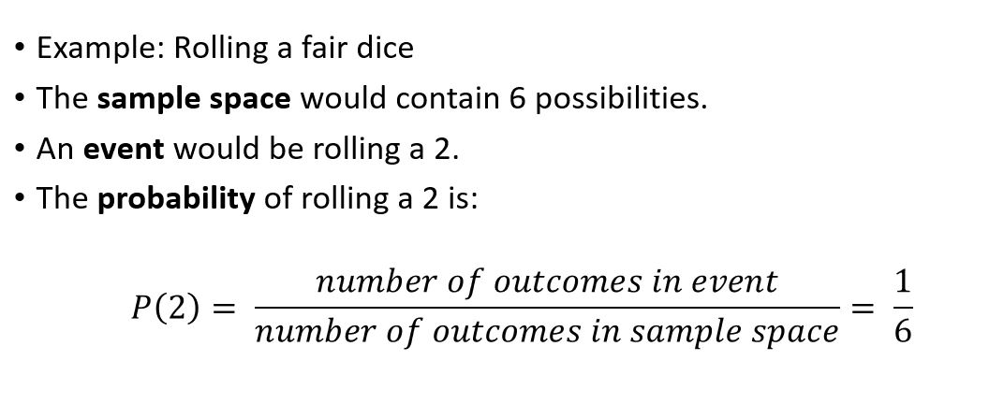
Probability
https://academo.org/demos/dice-roll-statistics/

Slide 4
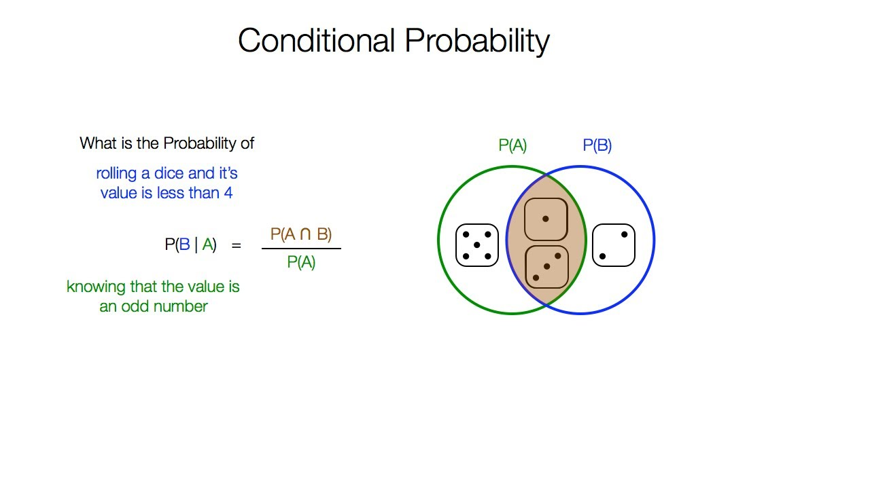

Conditional probability and Bayes theorem
A
B
Bayes theorem
$$P\left(B | A\right)=\frac{P\left(A | B\right)P(B)}{P(A)}$$
P(A)
P(B)
Most common application in ML :
Hypothesis Testing, Classification
P(A Ո B)
Notes:
Applications of Bayes rule in ML
https://blog.easysol.net/machine-learning-algorithms-4/
https://www.probabilitycourse.com/chapter1/1_4_0_conditional_probability.php
https://towardsdatascience.com/what-is-bayes-rule-bb6598d8a2fd

Slide 5
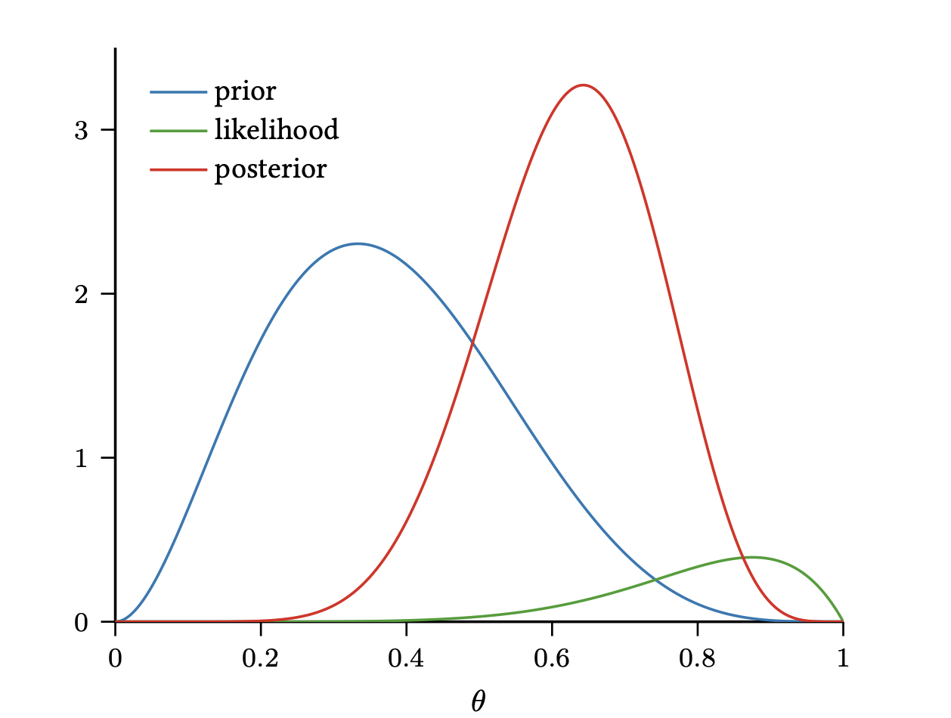
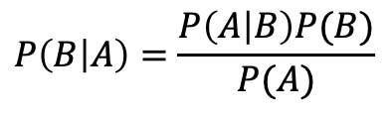
Bayesian Inference
Likelihood
Prior belief about B
(aka prior probability)
Probability of B given A
(aka posterior probability)
$$P\left(B | A\right)=\frac{P\left(A | B\right)P(B)}{P(A)}$$
Marginal likelihood or Model evidence
With each iteration of the Bayesian inference, the idea is to update your belief based on new evidence
Notes:
https://seeing-theory.brown.edu/bayesian-inference/index.html
https://towardsdatascience.com/probability-concepts-explained-bayesian-inference-for-parameter-estimation-90e8930e5348

Slide 6
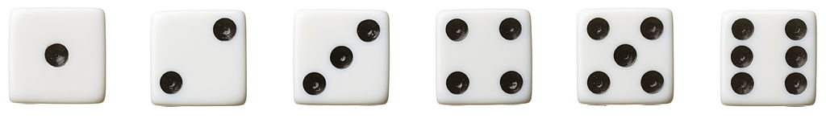
Random variables
Definition: A variable that takes on values from the sample space
Discrete random variable: can take only distinct values (ex. Rolling dice)
Continuous random variable: can take any value in an interval (ex. Predicting age)
X = 1
Notes:
Let's say we call our random variable X, then for the dice example we can say that our random variable X can be either 1,2,3,… and so on. These values are all within our sample space from 1 to 6 and are discrete values. Additionally, we can only take on one value from the sample space at a time.

Slide 7
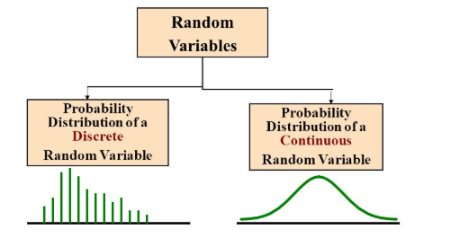
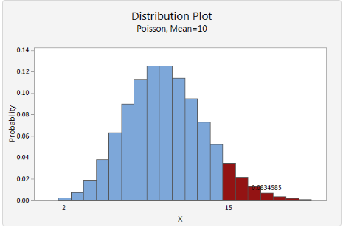
PDFs of discrete and continuous variables
Probability distribution of continuous and discrete random variables
Can't model continuous random variables with the same methods we used for discreate variables.
Discrete variables
The probability density function of a discrete random variable is simply the collection of all these probabilities.

Slide 8
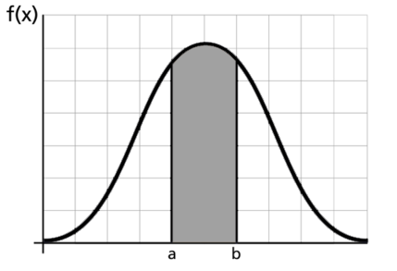

PDFs of discrete and continuous variables
Continuous variables
Model a continuous random variable with a curve f(x), called a probability density function
f(x) represents the height of the curve at point x.
For continuous random variables probabilities are under the curve.
$P\left(a≤X≤b\right)=\int_{a}^{b}{\left(x\right)f\left(x\right)dx}$

Slide 9
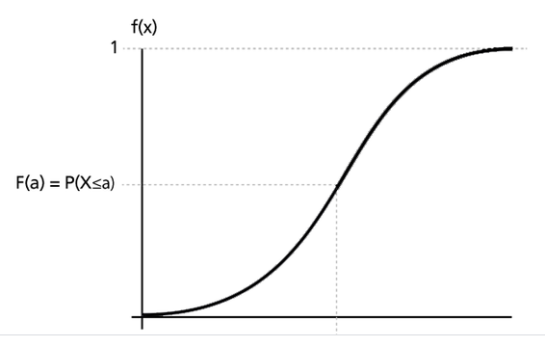
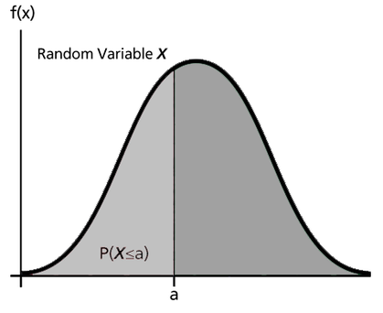


PDFs of discrete and continuous variables
PDF and CDF
Cumulative distribution function (cdf) is defined as:
$F\left(x\right)=P\left(X≤x\right)=\int_{0}^{x}{f\left(s\right)ds}$, X is a continuous random variable
Relationship: pdf and cdf
pdf
cdf
$$f\left(x\right)=\frac{d(F\left(x\right))}{dx}$$

Slide 10
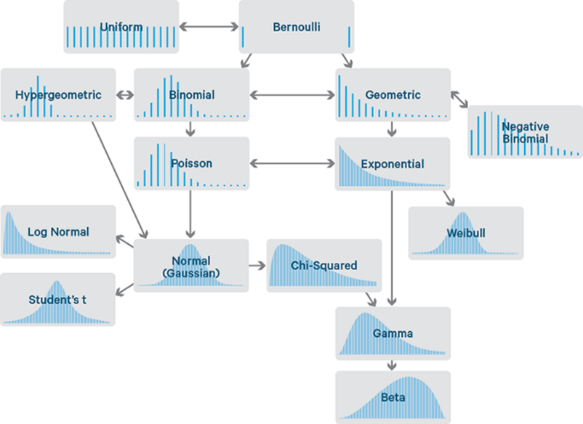
Famous distributions
Try it yourself!
Matlab Live Script
Matlab Script
Bayesian Inference
Notes:
http://statistics.zone/

Slide 11
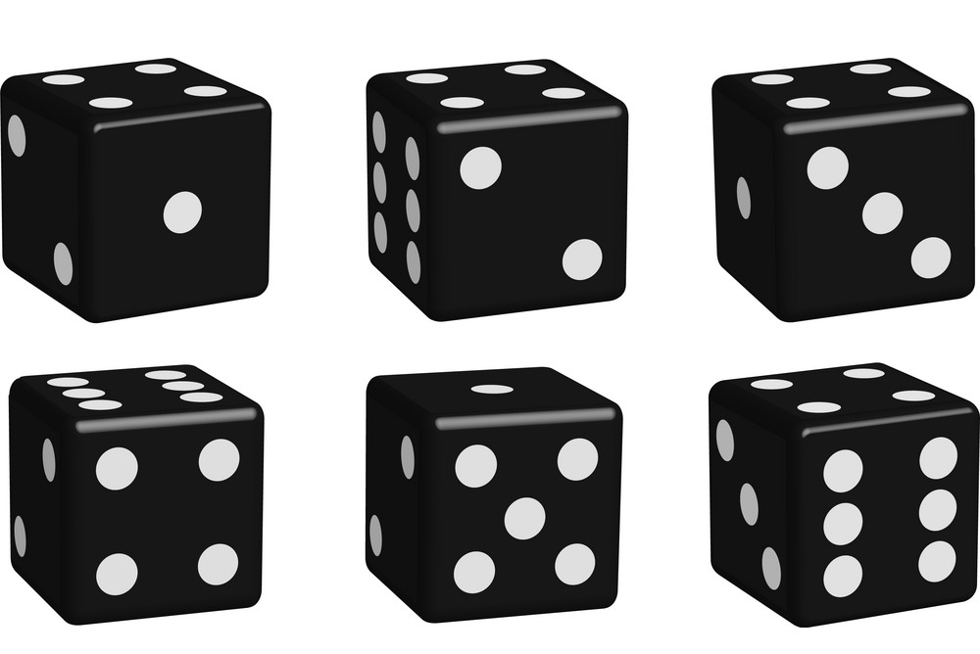


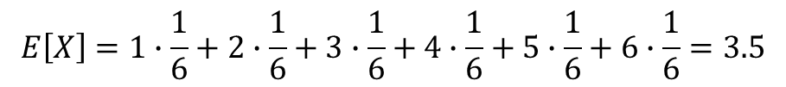






Sample standard deviation, variance, expected values, covariance, and correlation
Expected values
The average value of some random variable X is called the expected value, and the notation is E[X]
$$E\left[X\right]=\sum_{i=1}^{n}{x_{i}p_{i}}$$
$$x_{1}$$
$$x_{2}$$
$$x_{3}$$
$$E\left[X\right]=1∙\frac{1}{6}+2∙\frac{1}{6}+3∙\frac{1}{6}+4∙\frac{1}{6}+5∙\frac{1}{6}+6∙\frac{1}{6}=3.5$$
$$p_{i}=\frac{1}{6} for a fair dice$$
$$x_{4}$$
$$x_{5}$$
$$x_{6}$$
Don’t freak out! The expected value is just “mean”!!!

Slide 12
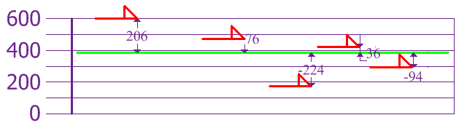
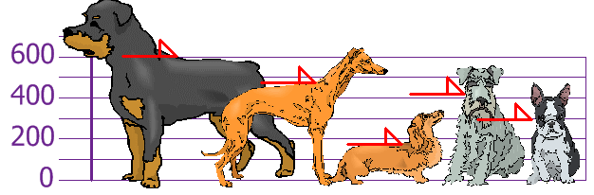
Sample standard deviation, variance, expected values, covariance, and correlation
Variance
A measure of how much values in the distribution vary on average with respect to the mean.
$$Variance= \frac{{206}^{2}+{76}^{2}+{(−244)}^{2}+{36}^{2}{+(−94)}^{2}}{5}=21704$$
$$Var\left[X\right]=E\left[{\left(X−E\left[X\right]\right)}^{2}\right]=E\left[X^{2}\right]−E{[X]}^{2}$$
Example:
Difference from the mean
Heights are: 600, 470, 170, 430, 300
E[X] = mean = 394
Notes:
https://towardsdatascience.com/getting-the-basics-of-correlation-covariance-c8fc110b90b4

Slide 13
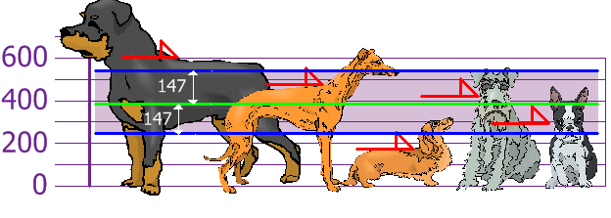
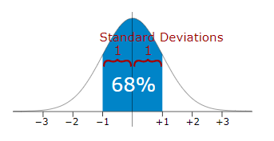

Sample standard deviation, variance, expected values, covariance, and correlation
Population Standard Deviation
A measure of the amount of variation of a set of values.
$$σ=\sqrt{\frac{1}{N}\sum_{i=1}^{N}{{(x_{i}−\overline{x})}^{2}}}$$
$$σ=\sqrt{E\left[{\left(X−E\left[X\right]\right)}^{2}\right]}=\sqrt{E\left[X^{2}\right]−E{[X]}^{2}}=\sqrt{Var[X]}$$
$$standard deviation= \sqrt{21704}≈147$$
Rottweilers are tall dogs. And Dachshunds are a bit short

Slide 14

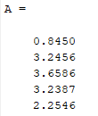
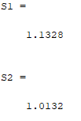


Sample standard deviation, variance, expected values, covariance, and correlation
Population Standard Deviation
Sample Standard Deviation
$$σ=\sqrt{\frac{1}{N}\sum_{i=1}^{N}{{(x_{i}−\overline{x})}^{2}}}$$
In Matlab
S= std(A) is by default normalized by N-1
S=std(A,1) is normalized by N
Sample std
$$σ=\sqrt{\frac{1}{N−1}\sum_{i=1}^{N}{{(x_{i}−\overline{x})}^{2}}}$$
Population std

Slide 15
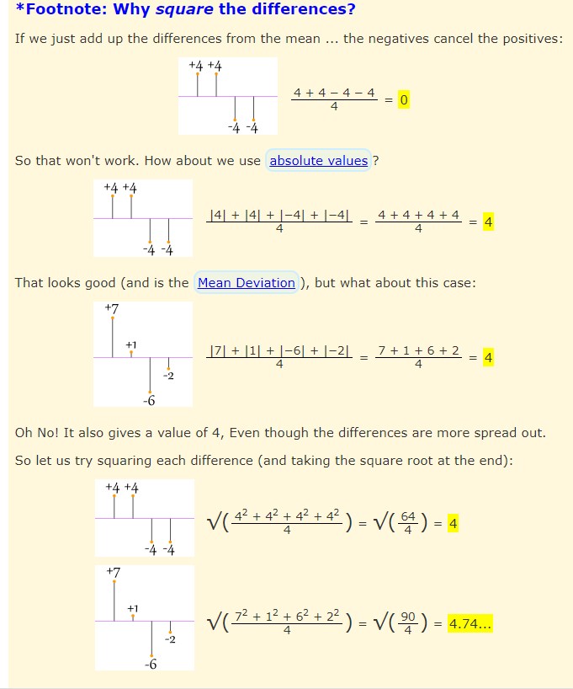

Slide 16
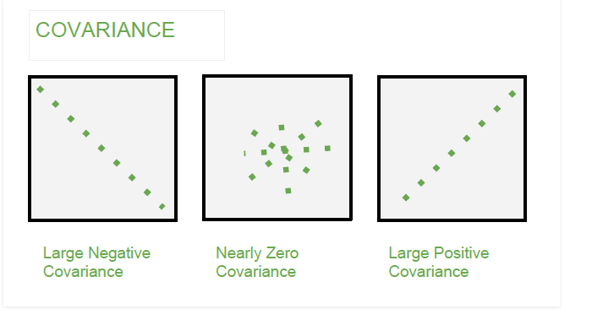
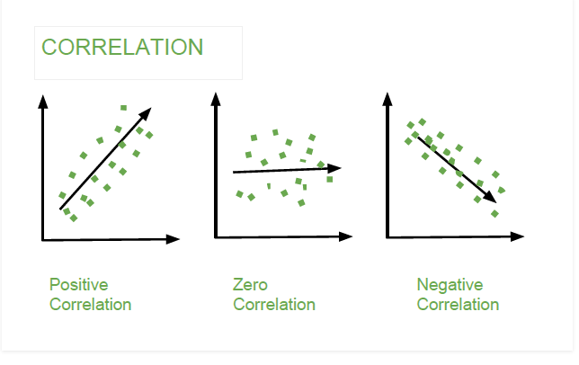

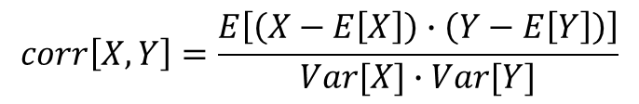
Sample standard deviation, variance, expected values, covariance, and correlation
Covariance
A measure of the joint probability for two random variables.
It describes how the two variables change together.
Correlation (Pearson’s correlation coefficient)
$$cov\left[X,Y\right]=E[(X−E[X])∙(Y−E[Y])]$$
$$corr\left[X,Y\right]=\frac{E\left[\left(X−E\left[X\right]\right)∙\left(Y−E\left[Y\right]\right)\right]}{Var[X]∙Var[Y]}$$
Covariance is dependent of scale (change if multiply by a number), but correlation is independent of the scale.

Slide 17
Additional Resources
https://towardsdatascience.com/probability-fundamentals-of-machine-learning-part-1-a156b4703e69
https://towardsdatascience.com/machine-learning-probability-statistics-f830f8c09326
http://statistics.zone/
https://www.probabilitycourse.com/chapter1/1_4_0_conditional_probability.php
https://towardsdatascience.com/what-is-bayes-rule-bb6598d8a2fd

